Slide 1






WHY POWER BI IS BETTER THAN EXCEL
BUSINESS PERSPECTIVE

Slide 2


CONTENT
01
02
03
04
05
Overview
Key Differences
Power BI Feature
Power BI Visualizations
Different Chart in Power BI
06
07
08
09
10
KPI’s
Data Analysis Capabilities
Collaboration and Cloud Integration
Forecasting
Conclusion and Case Study

Slide 3

OVERVIEW
Excel: A powerful tool for spreadsheets, data analysis, and financial reporting, widely used in business operations.
Power BI: A modern business analytics tool for transforming data into actionable insights, widely used for decision-making.

Slide 4





KEY DIFFERENCES
Data Handling
Data Visualization
Collaboration
Automation
Power BI manages larger data volumes, enabling businesses to analyze millions of records with ease.
Power BI provides interactive dashboards and advanced visualizations, helping businesses understand trends and KPIs better.
Power BI's cloud-based platform enhances team collaboration, essential for distributed teams.
.
Power BI's automated data refreshes streamline reporting, reducing manual efforts for business analysts.
.

Slide 5

Feature | Power BI | Excel
Handling Large Datasets | Efficient compression for large datasets (e.g., 300MB .csv files). Combines multiple datasets seamlessly. Maintains performance with massive data. | Struggles with very large datasets. Combining multiple filesis cumbersome. Performance issues withlarge files.
Trend Analysis | Built-in Time Intelligence: Easily view trends with pre-built time functions. Date Dimension Table: Createand link with data quickly. Time-Based Metrics: Generatemeasures like year- to-date revenue easily. | Manual Time Analysis: Requires complex macros for time trends. Date Handling: No built-in timeintelligence; needs manual setup. Time-Based Metrics: Difficult to create and manage.
Design and Customization | Drag-and-Drop Interface: Easy to design and customize. Themes (.json files): Simple import of consistent branding themes. Format Painter: Copy formatting across visuals. Visual Formatting: Customizablevisual elements like markers and datalabels. | Manual Design: Limited drag-and-drop functionality. Design Consistency: Difficult to maintain consistent branding. Manual Formatting: Requires manual adjustment for each visual.

Slide 6
Feature | Power BI | Excel
Cloud-Based Features | Publishing: Publish to the secure Power BI Service. Quick Insights: Automated insights from data. Natural Language Query: Type questions and get answers in visual form. Personalized Dashboards: Create and customize dashboards from various reports. Alerts: Set up email notifications for KPIs. | Sharing: Manual distribution via email or shared drives. Insights: No automated insight generation. Query: No natural language query capabilities. Dashboards: Limited dashboard customization. Alerts: No built-in alertsystem for KPIs.
Row-Level Security | Setup: Easy to set up security filters and roles. Role Management: Define roles and apply filters for different user groups. Data Access: Controls visibility based on user roles. | Setup: More complex and manualsetup for data security. Role Management: Difficult to managesecurity without additional tools. Data Access: Limited control over data visibility.

Slide 7



POWER BI FEATURES
01
Data Connectivity: Power BI integrates with numerous business data sources (e.g., CRM, ERP systems), crucial for comprehensive reporting.
02
Real-time Dashboards: Businesses can monitor live data (e.g., sales performance, supply chain metrics) and respond quickly to changes.
03
AI Capabilities: Power BI uses AI to detect patterns in data, allowing companies to forecast demand and identify opportunities.

Slide 8



POWER BI VISUALIZATIONS
Power BI Visualizations transform complex data into interactive and insightful visual representations, enabling users to uncover trends, patterns, and actionable insights through dynamic charts, graphs, and dashboards.
Financial Performance
Customer Segmentation
Sales Analysis
Ex.
Waterfall charts
Gauge chart
Decomposition tree chart
Ex.
Waterfall charts
Ex. Decomposition tree charts

Slide 9
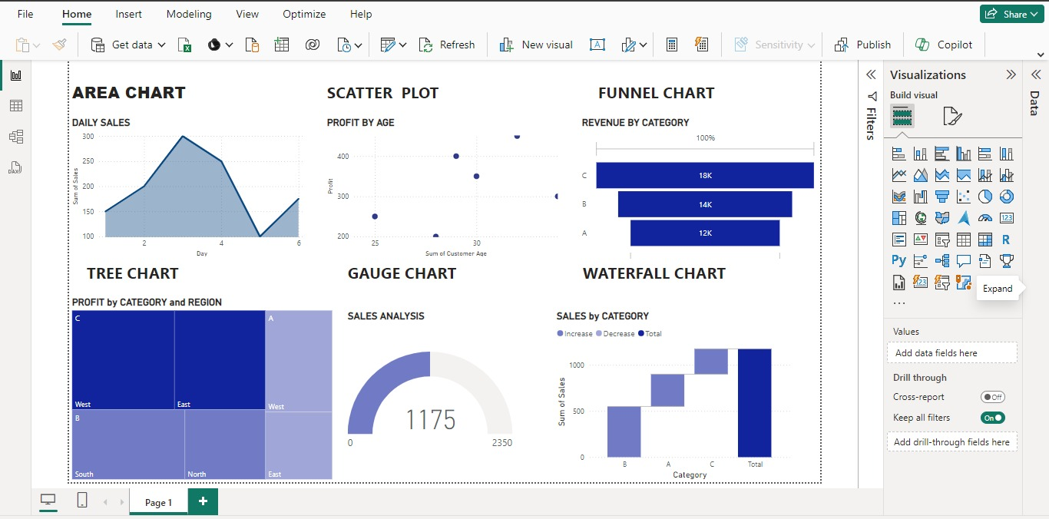
Your paragraph text
Different Charts in Power BI

Slide 10
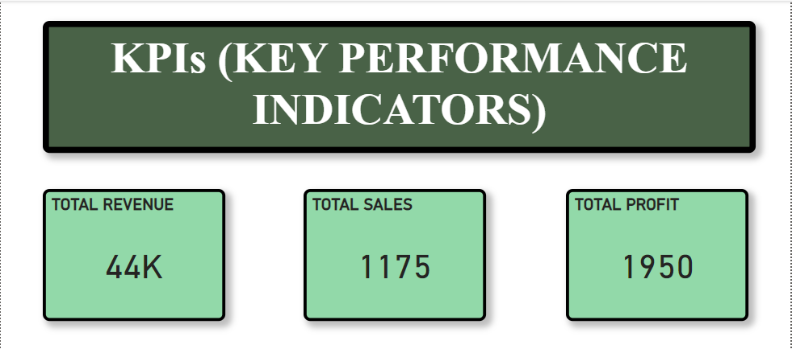
KPIs (Key Performance Indicators) are metrics used to evaluate the success of an organization or a particular activity in meeting its business objectives. KPIs in Power BI help track performance, identify trends, and make data-driven decisions.

Slide 11

DATA ANALYSIS CAPABILITIES
Excel: Useful for basic financial reporting, budgeting, and small-scale data analysis. Limitations arise with complex datasets
Power BI: Ideal for advanced analytics, such as sales forecasting and customer behavior analysis, which are vital for growing businesses.
Automation: Power BI's automated data refreshes streamline reporting, reducing manual efforts for business analysts.

Slide 12
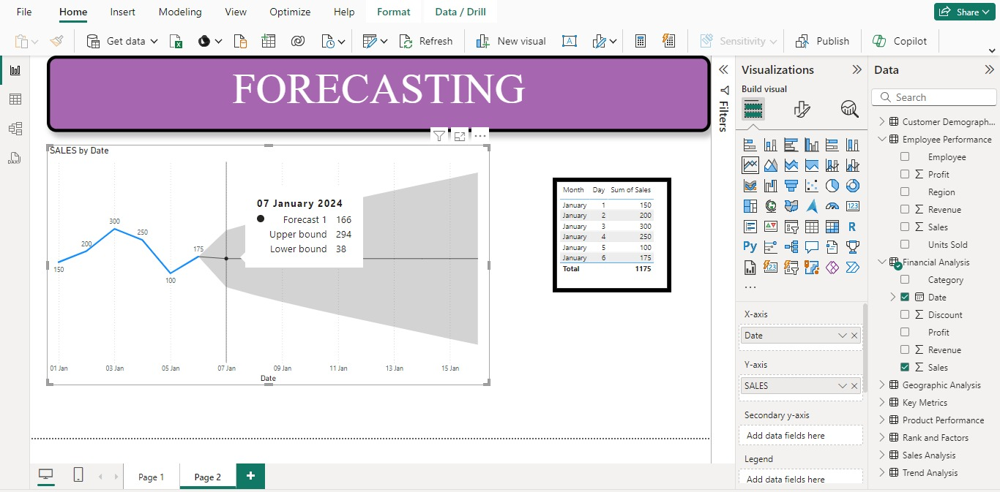
Forecasting in Power BI refers to the process of using historical data to predict future values or trends. Power BI provides built-in forecasting capabilities that allow users to create predictive models and visualize future trends directly within their reports and dashboards.

Slide 13

COLLABORATION AND CLOUD INTEGRATION
Power BI
Excel
Example
Cloud-based sharing makes it easy for teams across locations to collaborate on business reports in real time.
Suitable for smaller teams using shared files, but lacks the real-time collaborative features crucial for large organizations.
A retail company uses Power BI to share real-time sales data with all its store managers, enabling them to adjust strategies quickly.

Slide 14





CONCLUSION
Power BI: Perfect for businesses seeking advanced analytics, collaboration, and large-scale data processing.

Slide 15
CASE STUDY
Improving Production Efficiency
Company: XYZ Manufacturing Inc.
Solution: Integrated data from production lines and used Power BI dashboards to visualize metrics like machine uptime and cycle times.
Impact: Increased production efficiency by 15% and reduced operational costs by 10%
Enhancing Supply Chain Management
Company: ABC Electronics Ltd.
Solution: Combined data from suppliers and inventory systems in Power BI, used forecasting features to predict inventory needs.
Impact: Reduced stockouts by 20% and overstock by 15%.
Streamlining Financial Reporting
Company: GHI Chemical Manufacturing
Solution: Integrated financial data into Power BI, automating reporting and visualizing key metrics.
Impact: Reduced reporting time from days to minutes and improved budget management.

Slide 16










Power BI
THANK'S FOR WATCHING

